Slide 1
Module 7: WAN Concepts
Instructor Materials
Enterprise Networking, Security, and Automation v7.0 (ENSA)
Notes:
Cisco Networking Academy Program
Enterprise Networking, Security, and Automation v7.0 (ENSA)
Module 7: WAN Concepts

Slide 2
Instructor Materials – Module 7 Planning Guide
This PowerPoint deck is divided in two parts:
Instructor Planning Guide
Information to help you become familiar with the module
Teaching aids
Instructor Class Presentation
Optional slides that you can use in the classroom
Begins on slide # 9
Note: Remove the Planning Guide from this presentation before sharing with anyone.
For additional help and resources go to the Instructor Home Page and Course Resources for this course. You also can visit the professional development site on netacad.com, the official Cisco Networking Academy Facebook page, or Instructor Only FB group.
Notes:
2

Slide 3
What to Expect in this Module
To facilitate learning, the following features within the GUI may be included in this module:
Feature | Description
Animations | Expose learners to new skills and concepts.
Videos | Expose learners to new skills and concepts.
Check Your Understanding(CYU) | Per topic online quiz to help learners gauge content understanding.
Interactive Activities | A variety of formats to help learners gauge content understanding.
Syntax Checker | Small simulations that expose learners to Cisco command line to practice configuration skills.
PT Activity | Simulation and modeling activities designed to explore, acquire, reinforce, and expand skills.

Slide 4
What to Expect in this Module (Cont.)
To facilitate learning, the following features may be included in this module:
Feature | Description
Hands-On Labs | Labs designed for working with physical equipment.
Class Activities | These are found on the Instructor Resources page. Class Activities are designed to facilitate learning, class discussion, and collaboration.
Module Quizzes | Self-assessments that integrate concepts and skills learned throughout the series of topics presented in the module.
Module Summary | Briefly recaps module content.

Slide 5
Check Your Understanding
Check Your Understanding activities are designed to let students quickly determine if they understand the content and can proceed, or if they need to review.
Check Your Understanding activities do not affect student grades.
There are no separate slides for these activities in the PPT. They are listed in the notes area of the slide that appears before these activities.
Notes:
5

Slide 6
Module 7: Activities
What activities are associated with this module?
Page # | Activity Type | Activity Name | Optional?
7.1.6 | Check Your Understanding | Purpose of WANs | Recommended
7.2.9 | Check Your Understanding | WAN Operations | Recommended
7.3.5 | Check Your Understanding | Traditional WAN Connectivity | Recommended
7.4.5 | Check Your Understanding | Modern WAN Connectivity | Recommended
7.5.11 | Lab | Research Broadband Internet Access Options | Recommended
7.6.1 | Packet Tracer | WAN Concepts | Recommended
Notes:
6

Slide 7
Module 7: Best Practices
Prior to teaching Module 7, the instructor should:
Review the activities and assessments for this module.
Try to include as many questions as possible to keep students engaged during classroom presentation.
Topic 7.1
Ask the students or have a class discussion
Have a class discussion on the advantages and disadvantages of each WAN logical topology.
Can you think of scenarios of when single-carrier and dual-carrier WAN connections are used?
Topic 7.2
Ask the students or have a class discussion
Have students identify WAN terms from their descriptions.
Have a class discussion on the technologies that are used in serial and packet switched communications.
Notes:
7

Slide 8
Module 5: Best Practices (Cont.)
Topic 7.3
Ask the students or have a class discussion
Have you ever used traditional WAN technologies when connecting to the Internet?
Have students categories connectivity technologies as either circuit-switched or packet-switched.
Topic 7.4
Ask the students or have a class discussion
Have a discussion on the various modern WAN connectivity options.
Why is MPLS such a versatile WLAN connectivity option?
Topic 7.5
Ask the students or have a class discussion
Describe an occasion when you have connected to a remote network over a VPN?
Compare and contrast DSL with Cable technology.
Notes:
8

Slide 9
Module 7: WAN Concepts
Enterprise Networking, Security, and Automation v7.0 (ENSA)
Notes:
Cisco Networking Academy Program
Enterprise Networking, Security, and Automation v7.0 (ENSA)
Module 7: WAN Concepts

Slide 10
Module Objectives
Module Title: WAN Concepts
Module Objective: Explain how WAN access technologies can be used to satisfy business requirements.
Topic Title | Topic Objective
Purpose of WANs | Explain the purpose of a WAN.
WAN Operations | Explain how WANs operate.
Traditional WAN Connectivity | Compare traditional WAN connectivity options.
Modern WAN Connectivity | Compare modern WAN connectivity options.
Internet-Based Connectivity | Compare internet-based connectivity options.
Notes:
10
7 – WAN Concepts
7.0.2 - What will I learn to do in this Module?

Slide 11
7.1 Purpose of WANs
Notes:
7.0 - WAN Concepts
7.1 – Purpose of WANs

Slide 12
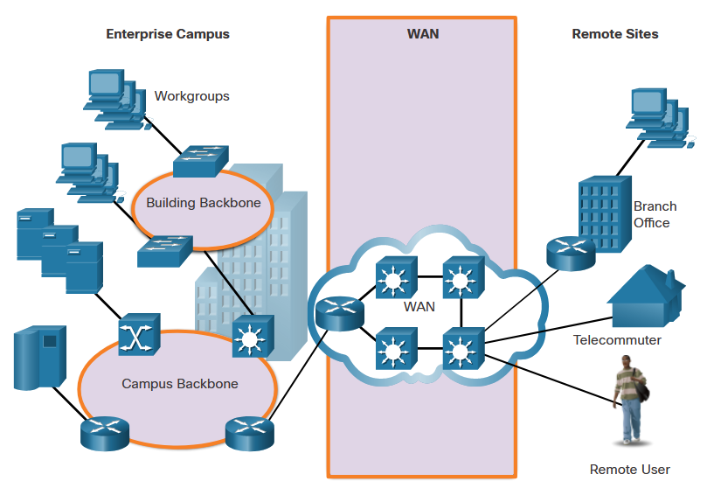
Purpose of WANs LANs and WANs
A WAN is a telecommunications network that spans over a relatively large geographical area and is required to connect beyond the boundary of the LAN.
Local Area Networks (LANs) | Wide Area Networks (WANs)
LANs provide networking services within a small geographic area. | WANs provide networking services over large geographical areas.
LANs are used to interconnect local computers, peripherals, and other devices. | WANs are used to interconnect remote users, networks, and sites.
A LAN is owned and managed by an organization or home user. | WANs are owned and managed by internet service, telephone, cable, and satellite providers.
Other than the network infrastructure costs, there is no fee to use a LAN. | WAN services are provided for a fee.
LANs provide high bandwidth speeds using wired Ethernet and Wi-Fi services. | WANs providers offer low to high bandwidth speeds, over long distances.
Notes:
7.0 - WAN Concepts
7.1 – Purpose of WANs
7.1.1 – LANs and WANs

Slide 13
Purpose of WANs Private and Public WANs
A private WAN is a connection that is dedicated to a single customer.
Private WANs provide the following:
Guaranteed service level
Consistent bandwidth
Security
A public WAN connection is typically provided by an ISP or telecommunications service provider using the internet. In this case, the service levels and bandwidth may vary, and the shared connections do not guarantee security.
Notes:
7.0 - WAN Concepts
7.1 – Purpose of WANs
7.1.2 – Private and Public WANs

Slide 14
Purpose of WANs WAN Topologies
Physical topologies describe the physical network infrastructure used by data when it is travelling from a source to a destination. The physical WAN topology used in WANs is complex and for the most part, unknown to users. Consider a user in New York establishing a video conference call with a user in Tokyo, Japan. Other than the user’s internet connection in New York, it would not be feasible to identify the all of the actual physical connections that are needed to support the video call.
Instead, WAN topologies are described using a logical topology. Logical topologies describe the virtual connection between the source and destination. For example, the video conference call between the user in New York and Japan would be a logical point-to-point connection.
WANs are implemented using the following logical topology designs:
Point-to-Point Topology
Hub-and-Spoke Topology
Dual-homed Topology
Fully Meshed Topology
Partially Meshed Topology
Note: Large networks usually deploy a combination of these topologies.
Notes:
7.0 - WAN Concepts
7.1 – Purpose of WANs
7.1.3 – WAN Topologies

Slide 15
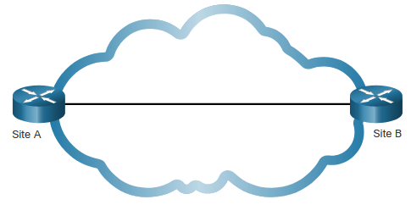
Purpose of WANs WAN Topologies (Cont.)
Point-to-Point Topology
Employs a point-to-point circuit between two endpoints.
Point-to-point links often involve dedicated, leased-line connections from the corporate edge point to the provider networks.
Involves a Layer 2 transport service through the service provider network. Packets sent from one site are delivered to the other site and vice versa.
The point-to-point connection is transparent to the customer network. It seems as if there is a direct physical link between two endpoints.
Note: It can become expensive if many point-to-point connections are required.
Notes:
7.0 - WAN Concepts
7.1 – Purpose of WANs
7.1.3 – WAN Topologies (Cont.)

Slide 16
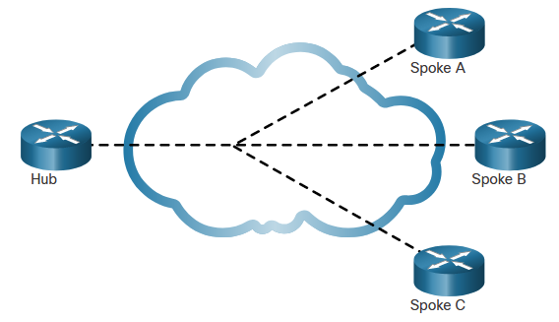
Purpose of WANs WAN Topologies (Cont.)
Hub-and-Spoke Topology
Enables a single interface on the hub router to be shared by all spoke circuits.
Spoke routers can be interconnected through the hub router using virtual circuits and routed subinterfaces.
A hub-and-spoke topology is a single-homed topology. There is only one hub router and all communication must go through it. Spoke routers can, thus, only communicate with each other through the hub router.
Note: The hub router represents a single point of failure. If it fails, inter-spoke communication also fails.
Notes:
7.0 - WAN Concepts
7.1 – Purpose of WANs
7.1.3 – WAN Topologies (Cont.)

Slide 17
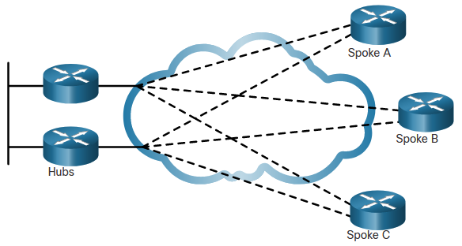
Purpose of WANs WAN Topologies (Cont.)
Dual-homed Topology
Offers enhanced network redundancy, load balancing, distributed computing and processing, and the ability to implement backup service provider connections.
More expensive to implement than single-homed topologies. This is because they require additional networking hardware, such as additional routers and switches.
More difficult to implement because they require additional, and more complex, configurations.
Notes:
7.0 - WAN Concepts
7.1 – Purpose of WANs
7.1.3 – WAN Topologies (Cont.)

Slide 18
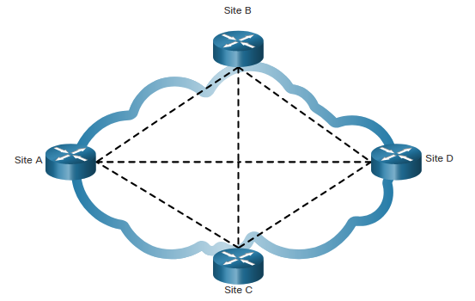
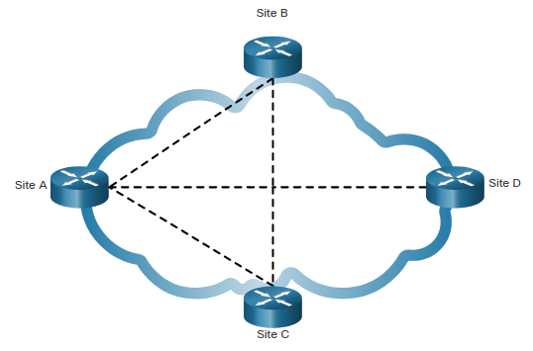
Purpose of WANs WAN Topologies (Cont.)
Fully Meshed Topology
Uses multiple virtual circuits to connect all sites
The most fault-tolerant topology
Partially Meshed Topology
Connects many but not all sites
Notes:
7.0 - WAN Concepts
7.1 – Purpose of WANs
7.1.3 – WAN Topologies (Cont.)

Slide 19
Purpose of WANs Carrier Connections
Another aspect of WAN design is how an organization connects to the internet. An organization usually signs a service level agreement (SLA) with a service provider. The SLA outlines the expected services relating to the reliability and availability of the connection.
The service provider may or may not be the actual carrier. A carrier owns and maintains the physical connection and equipment between the provider and the customer. Typically, an organization will choose either a single-carrier or dual-carrier WAN connection.
Notes:
7.0 - WAN Concepts
7.1 – Purpose of WANs
7.1.4 – Carrier Connections

Slide 20
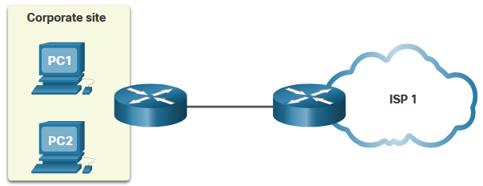
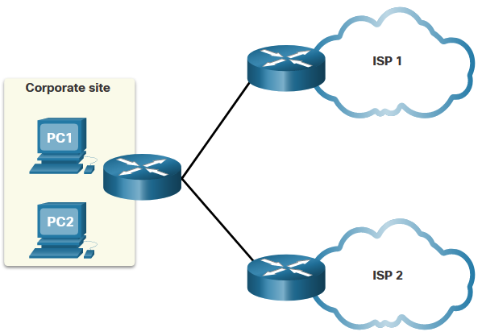
Purpose of WANs Carrier Connections (Cont.)
A single-carrier connection is when an organization connects to only one service provider. An SLA is negotiated between the organization and the service provider. Disadvantage: connectivity to the internet would be lost if the carrier link or the provider router failed.
A dual-carrier connection provides redundancy and increases network availability. The organization negotiates separate SLAs with two different service providers. The organization should ensure that the two providers each use a different carrier. Although more expensive to implement, the second connection can be used for redundancy as a backup link. It could also be used to improve network performance and load balance internet traffic.
Notes:
7.0 - WAN Concepts
7.1 – Purpose of WANs
7.1.4 – Carrier Connections (Cont.)

Slide 21
Purpose of WANs Evolving Networks
Network requirements of a company can change dramatically as the company grows over time.
A network must meet the day-to-day operational needs of business, and it must be able to adapt and grow as a company changes.
Network designers and administrators meet these challenges by carefully choosing network technologies, protocols, and service providers.
Networks can be optimized by using a variety of network design techniques and architectures.
To illustrate differences between network size, we will use a fictitious company called SPAN Engineering as it grows from a small, local, business into a global enterprise.
SPAN Engineering, an environmental consulting firm, has developed a special process for converting household waste into electricity and is developing a small pilot project for a municipal government in its local area.
Notes:
7.0 - WAN Concepts
7.1 – Purpose of WANs
7.1.5 – Evolving Networks

Slide 22
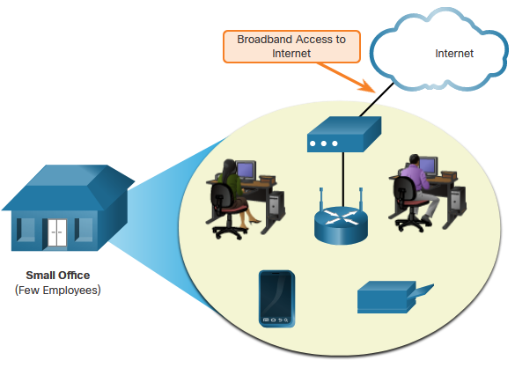
Purpose of WANs Evolving Networks (Cont.)
Small Network
SPAN, a small fictitious company, started with a few employees in a small office.
Uses a single LAN connected to a wireless router for sharing data and peripherals.
Connection to the internet is through a common broadband service called Digital Subscriber Line (DSL)
IT support is contracted from the DSL provider.
Notes:
7.0 - WAN Concepts
7.1 – Purpose of WANs
7.1.5 – Evolving Networks (Cont.)

Slide 23
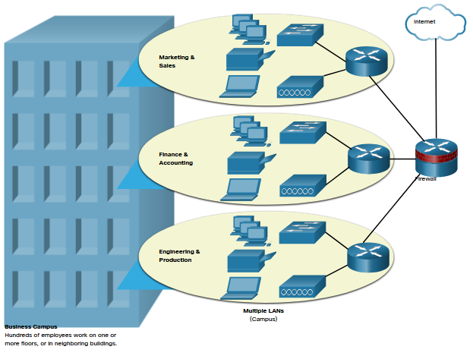
Purpose of WANs Evolving Networks (Cont.)
Campus Network
Within a few years SPAN grew and required several floors of a building.
The company now required a Campus Area Network (CAN). A CAN interconnects several LANs within a limited geographical area. Multiple LANs are required to segment the various departments that are connecting to multiple switches in a campus network environment.
The network includes
dedicated servers for email, data transfer, and file storage, and web-based productivity tools and applications.
A firewall secures internet access to corporate users.
In-house IT staff to support and maintain the network.
Notes:
7.0 - WAN Concepts
7.1 – Purpose of WANs
7.1.5 – Evolving Networks (Cont.)

Slide 24
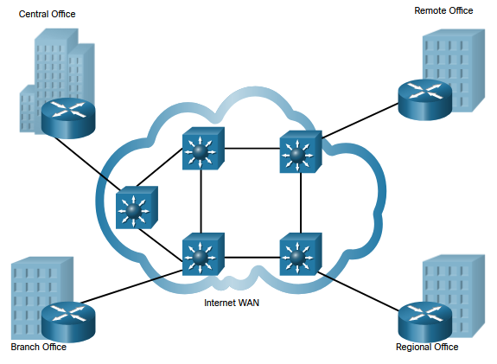
Purpose of WANs Evolving Networks (Cont.)
Branch Network
A few years later, the company expanded and added a branch site in the city, and remote and regional sites in other cities.
The company now required a metropolitan area network (MAN) to interconnect sites within the city. A MAN is larger than a LAN, but smaller than a WAN.
To connect to the central office, branch offices in nearby cities used private dedicated lines through their local service provider.
Notes:
7.0 - WAN Concepts
7.1 – Purpose of WANs
7.1.5 – Evolving Networks (Cont.)

Slide 25
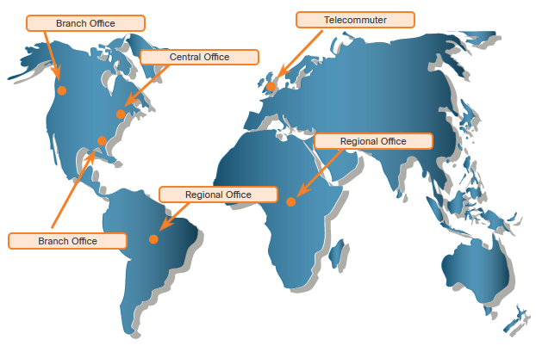
Purpose of WANs Evolving Networks (Cont.)
Distributed Network
SPAN Engineering has now been in business for 20 years and has grown to thousands of employees distributed in offices worldwide.
Site-to-site and remote access Virtual Private Networks (VPNs) enable the company to use the internet to connect easily and securely with employees and facilities around the world.
Notes:
7.0 - WAN Concepts
7.1 – Purpose of WANs
7.1.5 – Evolving Networks (Cont.)
7.1.6 – Check Your Understanding – Purpose of WANs

Slide 26
7.2 WAN Operation
Notes:
7.0 - WAN Concepts
7.2 – WAN Operations

Slide 27
WAN Operations WAN Standards
Modern WAN standards are defined and managed by a number of recognized authorities including the following:
TIA/EIA - Telecommunications Industry Association and Electronic Industries Alliance
ISO - International Organization for Standardization
IEEE - Institute of Electrical and Electronics Engineers
Notes:
7.0 - WAN Concepts
7.2 – WAN Operations
7.2.1 – WAN Standards

Slide 28
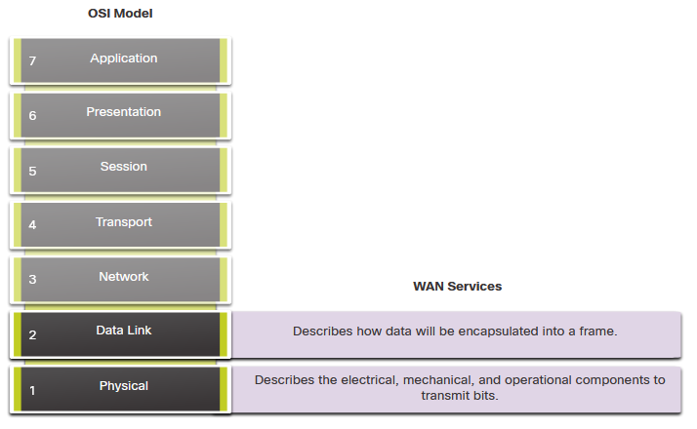
WAN Operations WANs in the OSI Model
Most WAN standards focus on the physical layer and the data link layer.
Service providers commonly use high-bandwidth optical fiber media to span long distances (i.e., long haul) using the following Layer 1 optical fiber protocols
Synchronous Digital Hierarchy (SDH)
Synchronous Optical Networking (SONET)
Dense Wavelength Division Multiplexing (DWDM)
Layer 2 Protocols
Broadband (i.e., DSL and Cable)
Wireless
Ethernet WAN (Metro Ethernet)
Multiprotocol Label Switching (MPLS)
Point-to-Point Protocol (PPP) (less used)
High-Level Data Link Control (HDLC) (less used)
Frame Relay (legacy)
Asynchronous Transfer Mode (ATM) (legacy)
Notes:
7.0 - WAN Concepts
7.2 – WAN Operations
7.2.2 – WANs in the OSI Model

Slide 29
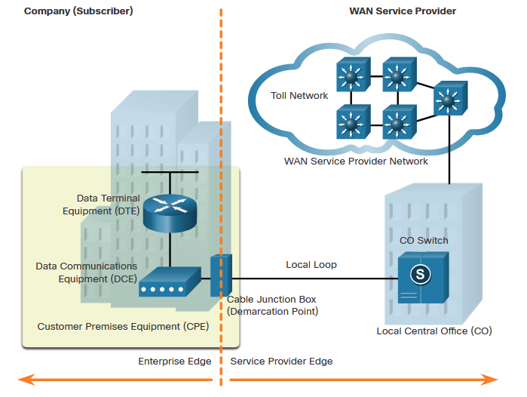
WAN Operations Common WAN Terminology
The WAN physical layer describes the physical connections between the company network and the service provider network. There are specific terms used to describe WAN connections between the subscriber (i.e., the company / client) and the WAN service provider. ZIE CURSUS
WAN Term | Description
Data Terminal Equipment (DTE) | Connects the subscriber LANs to the WAN communication device
Data Communications Equipment (DCE) | Device used to communicate with the provider
Customer Premises Equipment (CPE) | This is the DTE and DCE devices located on the enterprise edge
Point-of-Presence (POP) | The point where the subscriber connects to the service provider network
Demarcation Point | The physical location in a building or complex that officially separates the CPE from service provider equipment.
Notes:
7.0 - WAN Concepts
7.2 – WAN Operations
7.2.3 – Common WAN Terminology

Slide 30
WAN Operations Common WAN Terminology (Cont.)
WAN Term | Description
Local Loop (last mile) | The copper or fiber cable that connects the CPE to the CO of the service provider
Central office (CO) | The local service provider facility or building that connects the CPE to the provider network
Toll network | Includes backhaul, long-haul, all-digital, fiber-optic communications lines, switches, routers, and other equipment inside the WAN provider network
Backhaul network | Connects multiple access nodes of the service provider network
Backbone network | Large, high-capacity networks used to interconnect service provider networks and to create a redundant network.
Notes:
7.0 - WAN Concepts
7.2 – WAN Operations
7.2.4 – Common WAN Terminology (Cont.)

Slide 31
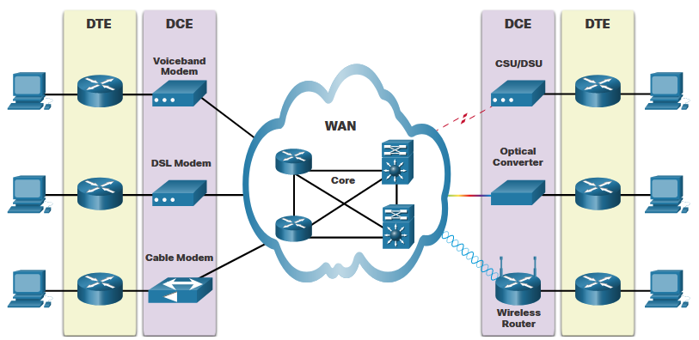
WAN Operations WAN Devices
There are many types of devices that are specific to WAN environments (zie cursus).
WAN Device | Description
Voiceband Modem | Dial-up modem – uses telephone lines Legacy device
DSL Modem / Cable Modem | Collectively known as broadband modems, these high-speed digital modems connect to the DTE router using Ethernet.
CSU/DSU | Digital-leased lines require a CSU and a DSU. It connects a digital device to a digital line.
Optical Converter | Connect fiber-optic media to copper media and convert optical signals to electronic pulses.
Wireless Router / Access Point | Devices are used to wirelessly connect to a WAN provider.
WAN Core devices | WAN backbone consists of multiple high-speed routers and Layer 3 switches.
Notes:
7.0 - WAN Concepts
7.2 – WAN Operations
7.2.4 – WAN Devices

Slide 32
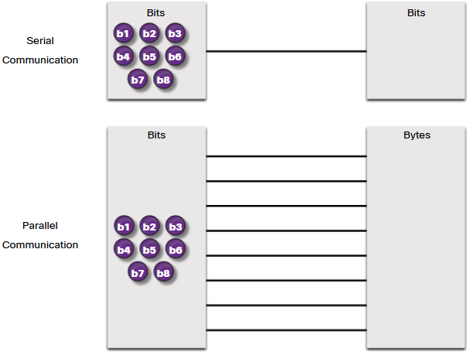
WAN Operations Serial Communication
Almost all network communications occur using a serial communication delivery. Serial communication transmits bits sequentially over a single channel.
In contrast, parallel communications simultaneously transmit several bits using multiple wires.
As the cable length increases, the synchronization timing between multiple channels becomes more sensitive to distance. For this reason, parallel communication is limited to very short distances
Animatie in cursus
Notes:
7.0 - WAN Concepts
7.2 – WAN Operations
7.2.5 – Serial Communication

Slide 33
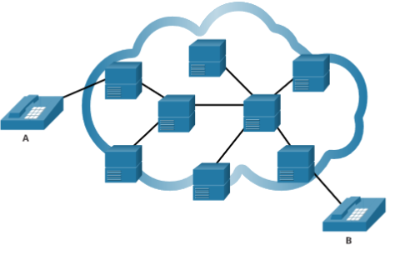
WAN Operations Circuit-Switched Communication
A circuit-switched network establishes a dedicated circuit (or channel) between endpoints before the users can communicate.
Establishes a dedicated virtual connection through the service provider network before communication can start.
All communication uses the same path.
The entire fixed capacity allocated to the circuit is available for the duration of the connection, regardless of whether there is information to transmit or not. This can lead to inefficiencies in circuit usage. For this reason, circuit switching is generally not suited for data communication.
The two most common types of circuit-switched WAN technologies are the public switched telephone network (PSTN) and the legacy Integrated Services Digital Network (ISDN).
Notes:
7.0 - WAN Concepts
7.2 – WAN Operations
7.2.6 – Circuit-Switched Communication

Slide 34
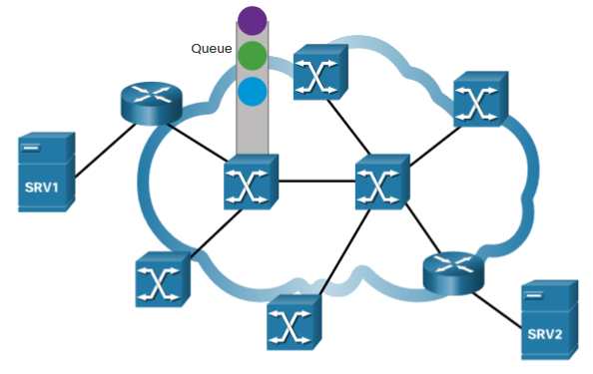
WAN Operations Packet-Switched Communication
Network communication is most commonly implemented using packet-switched communication.
Segments traffic data into packets that are routed over a shared network.
Much less expensive and more flexible than circuit switching.
Common types of packet-switched WAN technologies are:
Ethernet WAN (Metro Ethernet),
Multiprotocol Label Switching (MPLS)
Frame Relay
Asynchronous Transfer Mode (ATM).
Notes:
7.0 - WAN Concepts
7.2 – WAN Operations
7.2.7 – Packet-Switched Communication

Slide 35
WAN Operations SDH, SONET, and DWDM
Service provider networks use fiber-optic infrastructures to transport user data between destinations. Fiber-optic cable is far superior to copper cable for long distance transmissions due to its much lower attenuation and interference.
There are two optical fiber OSI layer 1 standards available to service providers:
SDH - Synchronous Digital Hierarchy (SDH) is a global standard for transporting data over fiber-optic cable.
SONET - Synchronous Optical Networking (SONET) is the North American standard that provides the same services as SDH.
SDH/SONET define how to transfer multiple data, voice, and video communications over optical fiber using lasers or light-emitting diodes (LEDs) over great distances.
Dense Wavelength Division Multiplexing (DWDM) is a newer technology that increases the data-carrying capacity of SDH and SONET by simultaneously sending multiple streams of data (multiplexing) using different wavelengths of light.
Notes:
7.0 - WAN Concepts
7.2 – WAN Operations
7.2.8 – SDH, SONET, and DWDM
7.2.9 – Check Your Understanding – WAN Operations

Slide 36
7.3 Traditional WAN Connectivity
Notes:
7.0 - WAN Concepts
7.3 – Traditional WAN Connectivity

Slide 37
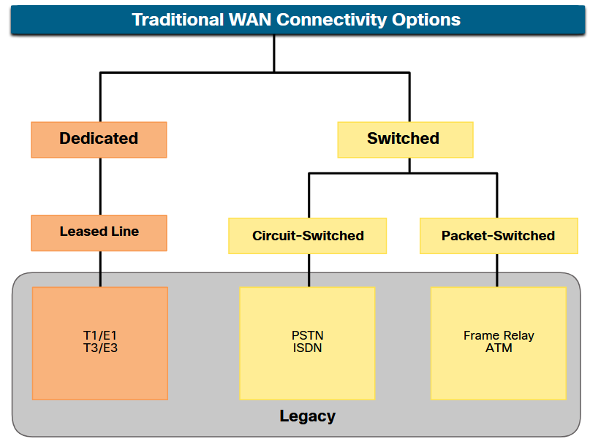
Traditional WAN Connectivity Traditional WAN Connectivity Options
To understand the WANs of today, it helps to know where they started.
When LANs appeared in the 1980s, organizations began to see the need to interconnect with other locations.
To do so, they needed their networks to connect to the local loop of a service provider.
This was accomplished by using dedicated lines, or by using switched services from a service provider.
Notes:
7.0 - WAN Concepts
7.3 – Traditional WAN Connectivity
7.3.1 – Traditional WAN Connectivity Options

Slide 38
Traditional WAN Connectivity Common WAN Terminology
Point-to-point lines could be leased from a service provider and were called “leased lines”. The term refers to the fact that the organization pays a monthly lease fee to a service provider to use the line.
Leased lines are available in different fixed capacities and are generally priced based on the bandwidth required and the distance between the two connected points.
There are two systems used to define the digital capacity of a copper media serial link:
T-carrier - Used in North America, T-carrier provides T1 links supporting bandwidth up to 1.544 Mbps and T3 links supporting bandwidth up to 43.7 Mbps.
E-carrier – Used in Europe, E-carrier provides E1 links supporting bandwidth up to 2.048 Mbps and E3 links supporting bandwidth up to 34.368 Mbps.
Notes:
7.0 - WAN Concepts
7.3 – Traditional WAN Connectivity
7.3.2– Common WAN Terminology

Slide 39
Traditional WAN Connectivity Common WAN Terminology (Cont.)
The table summarizes the advantages and disadvantages of leased lines.
Advantages
Simplicity | Point-to-point communication links require minimal expertise to install and maintain.
Quality | Point-to-point communication links usually offer high quality service, if they have adequate bandwidth.
Availability | Constant availability is essential for some applications, such as e-commerce. Point-to-point communication links provide permanent, dedicated capacity which is required for VoIP or Video over IP.
Disadvantages
Cost | Point-to-point links are generally the most expensive type of WAN access. The cost of leased line solutions can become significant when they are used to connect many sites over increasing distances.
Limited flexibility | WAN traffic is often variable, and leased lines have a fixed capacity, so that the bandwidth of the line seldom matches the need exactly.
Notes:
7.0 - WAN Concepts
7.3 – Traditional WAN Connectivity
7.3.2– Common WAN Terminology (Cont.)

Slide 40
Traditional WAN Connectivity Circuit-Switch Options
Circuit-switched connections are provided by Public Service Telephone Network (PSTN) carriers. The local loop connecting the CPE to the CO is copper media.
There are two traditional circuit-switched options:
Public Service Telephone Network (PSTN)
Dialup WAN access uses the PSTN as its WAN connection. Traditional local loops can transport binary computer data through the voice telephone network using a voiceband modem.
The physical characteristics of the local loop and its connection to the PSTN limit the rate of the signal to less than 56 kbps.
Integrated Services Digital Network (ISDN)
ISDN is a circuit-switching technology that enables the PSTN local loop to carry digital signals. This provided higher capacity switched connections than dialup access. ISDN provides for data rates from 45 Kbps to 2.048 Mbps.
ISDN has declined greatly in popularity due to high-speed DSL and other broadband services.
Notes:
7.0 - WAN Concepts
7.3 – Traditional WAN Connectivity
7.3.3– Circuit-Switched Options

Slide 41
Traditional WAN Connectivity Packet-Switch Options
Packet switching segments data into packets that are routed over a shared network. It allows many pairs of nodes to communicate over the same channel. Zie cursus voor meer uitleg.
There are two traditional (legacy) packet-switched options:
Frame Relay
Frame Relay is a simple Layer 2 non-broadcast multi-access (NBMA) WAN technology that is used to interconnect enterprise LANs.
Frame Relay creates PVCs which are uniquely identified by a data-link connection identifier (DLCI).
Asynchronous Transfer Mode (ATM)
Asynchronous Transfer Mode (ATM) technology is capable of transferring voice, video, and data through private and public networks.
ATM is built on a cell-based architecture rather than on a frame-based architecture. ATM cells are always a fixed length of 53 bytes.
Note: Frame relay and ATM networks have been largely replaced by faster Metro Ethernet and internet-based solutions.
Notes:
7.0 - WAN Concepts
7.3 – Traditional WAN Connectivity
7.3.4 – Packet-Switched Options
7.3.5 – Check Your Understanding – Traditional WAN Connectivity

Slide 42
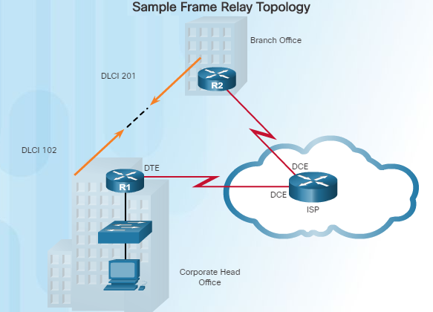
Private WAN Infrastructures Frame Relay
Frame Relay is a Layer 2 non-broadcast multi-access (NBMA) WAN technology used to interconnect enterprise LANs.
Data rates of up to 4 Mb/s with some providers offering higher rates
A single router interface can be used to connect multiple sites using PVCs ( permanent virtual circuits) which can carry both voice and data traffic.
An edge router only requires a single interface, even when multiple virtual circuits are used.
Frame Relay creates PVCs which are uniquely identified by a data-link connection identifier (DLCI). The PVCs and DLCIs ensure bidirectional communication between one DTE device to another.
R1 uses DLCI 102 to reach R2 while R2 uses DLCI 201 to reach R1.
Notes:
1.2 – Selecting a WAN Technology
1.2.2 – Private WAN Infrastructures
1.2.2.4 – Frame Relay

Slide 43
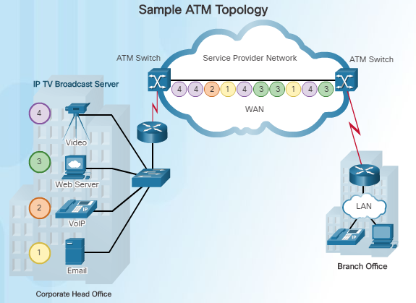
Private WAN Infrastructures ATM
Asynchronous Transfer Mode (ATM) technology is capable of transferring voice, video, and data through private and public networks.
ATM is built on a cell-based architecture rather than on a frame-based architecture.
Cells are always a fixed length of 53 bytes.
ATM cells contain a 5-byte ATM header followed by 48 bytes of ATM payload.
Small fixed-length cells are well-suited for voice and video traffic.
A typical ATM line needs almost 20% greater bandwidth than Frame Relay to carry the same volume of network traffic.
When the cell is carrying segmented network layer traffic, the overhead is higher since the ATM switch must be able to reassemble the packets at the destination.
Notes:
1.2 – Selecting a WAN Technology
1.2.2 – Private WAN Infrastructures
1.2.2.5 – ATM

Slide 44
7.4 Modern WAN Connectivity
Notes:
7.0 - WAN Concepts
7.4 – Modern WAN Connectivity

Slide 45
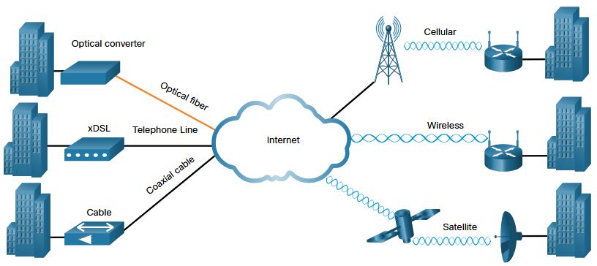
Modern WAN Connectivity Modern WANs
Modern WANS have more connectivity options than traditional WANs.
Enterprises now require faster and more flexible WAN connectivity options.
Traditional WAN connectivity options have rapidly declined in use because they are either no longer available, too expensive, or have limited bandwidth.
The figure displays the local loop connections most likely encountered today.
Notes:
7.0 - WAN Concepts
7.4 – Modern WAN Connectivity
7.4.1 – Modern WANs

Slide 46
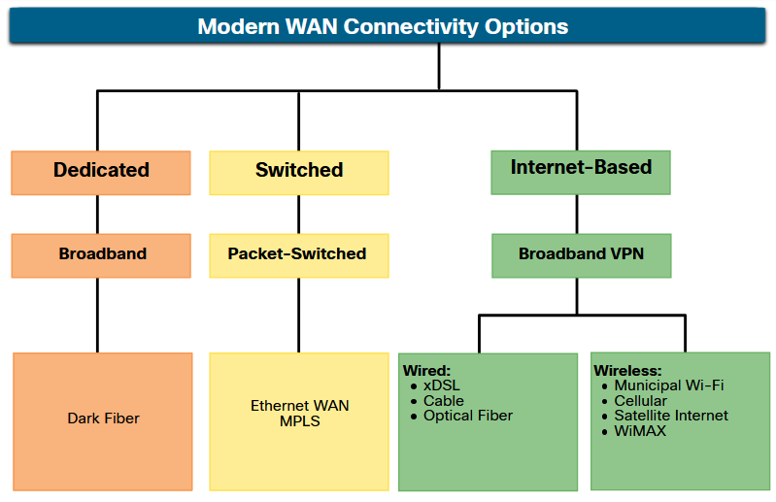
Modern WAN Connectivity Modern WAN Connectivity Options
New technologies are continually emerging. The figure summarizes the modern WAN connectivity options. Zie cursus.
Dedicated broadband
Fiber can be installed independently by an organization to connect remote locations directly together.
Dark fiber can be leased or purchased from a supplier.
Packet-switched
Metro Ethernet – Replacing many traditional WAN options.
MPLS – Enables sites to connect to the provider regardless of its access technologies.
Internet-based broadband
Organizations are now commonly using the global internet infrastructure for WAN connectivity.
Notes:
7.0 - WAN Concepts
7.4 – Modern WAN Connectivity
7.4.2 – Modern WAN Connectivity Options

Slide 47
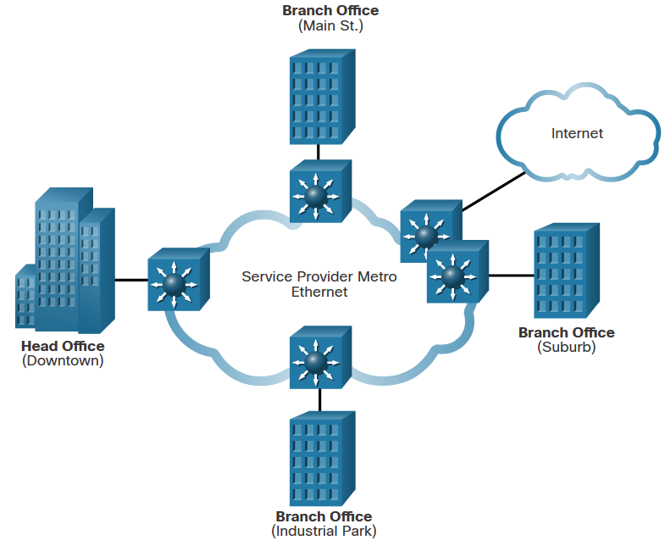
Modern WAN Connectivity Ethernet WAN
Ethernet was originally not suitable as a WAN access technology due primarily to the limited distance provided by copper media.
Service providers now offer Ethernet WAN service using fiber-optic cabling.
The Ethernet WAN service can go by many names, including the following:
Metropolitan Ethernet (Metro E)
Ethernet over MPLS (EoMPLS)
Virtual Private LAN Service (VPLS)
There are several benefits to an Ethernet WAN (zie cursus):
Reduced expenses and administration
Easy integration with existing networks
Enhanced business productivity
Note: Ethernet WANs have gained in popularity and are now commonly being used to replace the traditional serial point-to-point, Frame Relay and ATM WAN links.
Notes:
7.0 - WAN Concepts
7.4 – Modern WAN Connectivity
7.4.3 – Ethernet WAN

Slide 48
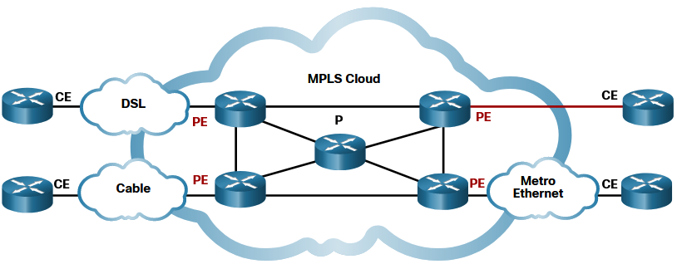
Modern WAN Connectivity MPLS
Multiprotocol Label Switching (MPLS) is a high-performance service provider WAN routing technology to interconnect clients without regard to access method or payload.
MPLS supports a variety of client access methods (e.g., Ethernet, DSL, Cable, Frame Relay).
MPLS can encapsulate all types of protocols including IPv4 and IPv6 traffic.
An MPLS router can be a customer edge (CE) router, a provider edge (PE) router, or an internal provider (P) router.
MPLS routers are label switched routers (LSRs). They attach labels to packets that are then used by other MPLS routers to forward traffic.
When traffic is leaving the CE, the MPLS PE router adds a short fixed-length label in between the frame header and packet header. MPLS P routers use the label to determine the next hop of the packet. The label is removed by the egress PE router when the packet leaves the MPLS network.
MPLS also provides services for QoS support, traffic engineering, redundancy, and VPNs.
Notes:
7.0 - WAN Concepts
7.4 – Modern WAN Connectivity
7.4.4 – MPLS
7.4.5 – Check Your Understanding – Modern WAN Connectivity

Slide 49
7.5 Internet-Based Connectivity
Notes:
7.0 - WAN Concepts
7.5 – Internet-Based Connectivity

Slide 50
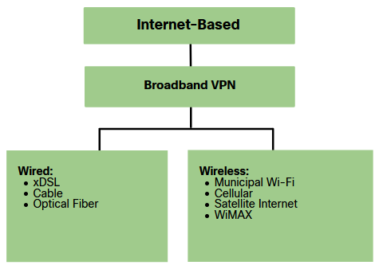
Internet-Based Connectivity Internet-Based Connectivity Options
Internet-based broadband connectivity is an alternative to using dedicated WAN options.
Internet-based connectivity can be divided into wired and wireless options.
Wired Options
Wired options use permanent cabling (e.g., copper or fiber) to provide consistent bandwidth, and reduce error rates and latency. Examples: DSL, cable connections, and optical fiber networks.
Wireless Options
Wireless options are less expensive to implement compared to other WAN connectivity options because they use radio waves instead of wired media to transmit data. Examples: cellular 3G/4G/5G or satellite internet services.
Wireless signals can be negatively affected by factors such as distance from radio towers, interference from other sources and weather.
Notes:
7.0 - WAN Concepts
7.5 – Internet-Based Connectivity
7.5.1 – Internet-Based Connectivity Options

Slide 51
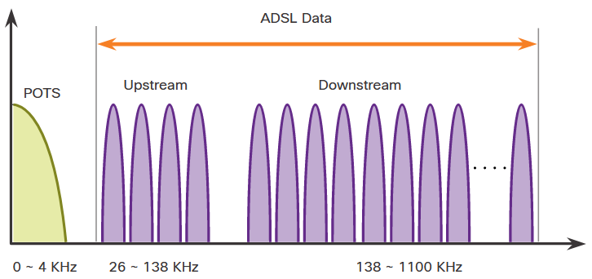
Internet-Based Connectivity DSL Technology
Digital Subscriber Line (DSL) is a high-speed, always-on, connection technology that uses existing twisted-pair telephone lines to provide IP services to users.
DSL are categorized as either Asymmetric DSL (ADSL) or Symmetric DSL (SDSL).
ADSL and ADSL2+ provide higher downstream bandwidth to the user than upload bandwidth.
SDSL provides the same capacity in both directions.
DSL transfer rates are dependent on the actual length of the local loop, and the type and condition of the cabling.
Notes:
7.0 - WAN Concepts
7.5 – Internet-Based Connectivity
7.5.2 – DSL Technology

Slide 52
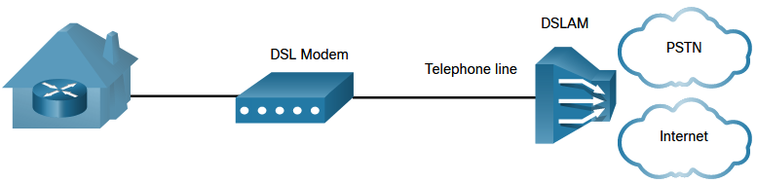
Internet-Based Connectivity DSL Connections
Service providers deploy DSL connections in the local loop. The connection is set up between the DSL modem and the DSL access multiplexer (DSLAM).
The DSL modem converts the Ethernet signals from the teleworker device to a DSL signal, which is transmitted to a DSL access multiplexer (DSLAM) at the provider location.
A DSLAM is located at the Central Office (CO) of the provider and concentrates connections from multiple DSL subscribers.
DSL is not a shared medium. Each user has a separate direct connection to the DSLAM. Adding users does not impede (belemmert) performance unless the DSLAM internet connection to the ISP, or to the internet, becomes saturated.
Notes:
7.0 - WAN Concepts
7.5 – Internet-Based Connectivity
7.5.3 – DSL Connections

Slide 53
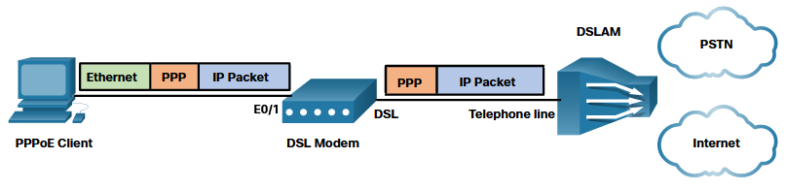
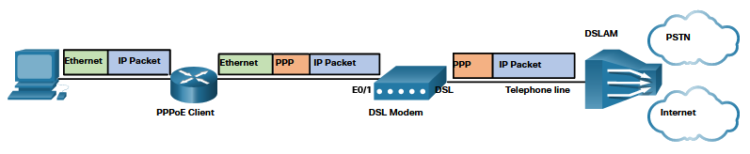
Internet-Based Connectivity DSL and PPP
ISPs use PPP as the Layer 2 protocol for broadband DSL connections.
PPP can be used to authenticate the subscriber.
PPP can assign a public IPv4 address to the subscriber.
PPP provides link-quality management features.
A DSL modem has a DSL interface to connect to the DSL network, and an Ethernet interface to connect to the client device. However, Ethernet links do not natively support PPP.
There are two ways PPP over Ethernet (PPPoE) can be deployed:
Host with PPPoE Client - The host runs a PPPoE client to obtain a public IP address from a PPPoE server located at the provider site. The PPPoE client software communicates with the DSL modem using PPPoE and the modem communicates with the ISP using PPP. Only one client can use the connection. Also, notice that there is no router to protect the inside network..
Router PPPoE Client - The router is the PPPoE client and obtains its configuration from the provider. The Client(s) communicate with the router using only Ethernet and are unaware of the DSL connection. In this topology, multiple clients can share the DSL connection.
Notes:
7.0 - WAN Concepts
7.5 – Internet-Based Connectivity
7.5.4 – DSL and PPP

Slide 54
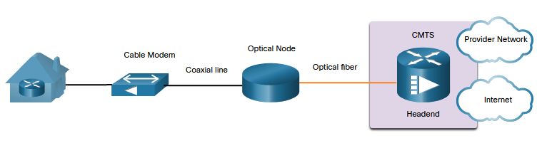
Internet-Based Connectivity Cable Technology
Cable technology is a high-speed always-on connection technology that uses a coaxial cable from the cable company to provide IP services to users.
The Data over Cable Service Interface Specification (DOCSIS) is the international standard for adding high-bandwidth data to an existing cable system.
Cable operators deploy hybrid fiber-coaxial (HFC) networks to enable high-speed transmission of data to cable modems. HFC uses fiber-optic and coaxial cable in different portions of the network. For example, the connection between the cable modem and optical node is coaxial cable, as shown in the figure.
The optical node converts RF signals to light pulses over fiber-optic cable.
The fiber media enables the signals to travel over long distances to the provider headend where a Cable Modem Termination System (CMTS) is located.
The headend contains the databases needed to provide internet access while the CMTS is responsible for communicating with the cable modems.
Note: All the local subscribers share the same cable bandwidth. As more users join the service, available bandwidth may drop below the expected rate.
Notes:
7.0 - WAN Concepts
7.5 – Internet-Based Connectivity
7.5.5 – Cable Technology

Slide 55
Internet-Based Connectivity Optical Fiber
Many municipalities, cities, and providers install fiber-optic cable to the user location. This is commonly referred to as Fiber to the x (FTTx) and includes the following:
Fiber to the Home (FTTH) - Fiber reaches the boundary of the residence.
Fiber to the Building (FTTB) - Fiber reaches the boundary of the building with the final connection to the individual living space being made via alternative means.
Fiber to the Node/Neighborhood (FTTN) – Optical cabling reaches an optical node that converts optical signals to a format acceptable for twisted pair or coaxial cable to the premise.
Note: FTTx can deliver the highest bandwidth of all broadband options.
Notes:
7.0 - WAN Concepts
7.5 – Internet-Based Connectivity
7.5.6 – Optical Fiber

Slide 56
Internet-Based Connectivity Wireless Internet-Based Broadband
Wireless technology uses the unlicensed radio spectrum to send and receive data.
Municipal Wi-Fi - Municipal wireless networks are available in many cities providing high-speed internet access for free, or for substantially less than the price of other broadband services.
Cellular – Increasingly used to connect devices to the internet using radio waves to communicate through a nearby mobile phone tower. 3G/4G/5G and Long-Term Evolution (LTE) are cellular technologies.
Satellite Internet - Typically used by rural users or in remote locations where cable and DSL are not available. A router connects to a satellite dish which is pointed to a service provider satellite in Geosynchronous orbit. Trees and heavy rains can impact the satellite signal.
WiMAX - Worldwide Interoperability for Microwave Access (WiMAX) is described in the IEEE standard 802.16 Provides high-speed broadband service with wireless access and provides broad coverage like a cell phone network rather than through small Wi-Fi hotspots.
Notes:
7.0 - WAN Concepts
7.5 – Internet-Based Connectivity
7.5.7 – Wireless Internet-Based Broadband

Slide 57
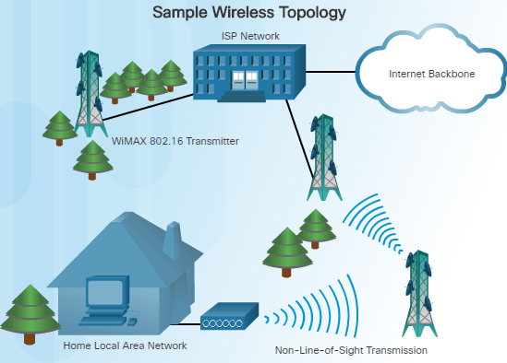
Public WAN Infrastructures Wireless
Until recently, one limitation of wireless access has been the need to be within the local transmission range (typically less than 100 feet) of a wireless router or a wireless modem. The following new developments are changing this:
Municipal Wi-Fi – Many cities have begun setting up municipal wireless networks for free or for substantially less than broadband.
WiMAX (IEEE 802.16) – Worldwide Interoperability for Microwave Access (WiMAX) is a new high-speed broadband technology that is just beginning to come into use. WiMAX provides broad coverage similar to a cell phone network rather than through Wi-Fi hotspots. WiMAX operates similar to Wi-Fi, but at higher speeds and over longer distances. and for a greater number of users.
WiMAX
Notes:
1.2 – Selecting a WAN Technology
1.2.3 – Public WAN Infrastructures
1.2.3.3 – Wireless

Slide 58
Public WAN Infrastructures Wireless (Cont.)
WiMAX uses a network of WiMAX towers that are similar to cell phone towers. Subscribers must be within 30 miles of a tower. They also need some type of WiMAX receiver and a special encryption code to get access to the base station.
Satellite Internet – Typically used by rural users where cable and DSL are not available. A VSAT provides two-way (upload and download) data communications. The upload speed is about one-tenth of the 500 kb/s download speed. Cable and DSL have higher download speeds, but satellite systems are about 10 times faster than analog modems.
To access satellite Internet services, subscribers need a satellite dish, two modems (uplink and downlink), and coaxial cables between the dish and the modem.
WiMAX
Notes:
1.2 – Selecting a WAN Technology
1.2.3 – Public WAN Infrastructures
1.2.3.3 – Wireless

Slide 59
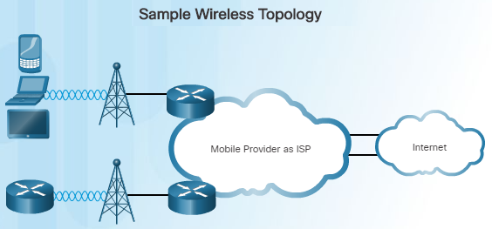
Public WAN Infrastructures 3G/4G Cellular
Increasingly, cellular service is another wireless WAN technology being used to connect users and remote locations where no other WAN access technology is available.
Phones, tablet computers, laptops, and even some routers can communicate through to the Internet using cellular technology.
These devices use radio waves to communicate through a nearby mobile phone tower. The device has a small radio antenna, and the provider has a much larger antenna sitting at the top of the tower somewhere within miles of the phone.
There are two common cellular industry terms:
3G/4G Wireless – Abbreviation for 3rd and 4th generation cellular access.
Long-Term Evolution (LTE) – Refers to a newer and faster technology and is considered to be part of the fourth generation (4G) technology.
Notes:
1.2 – Selecting a WAN Technology
1.2.3 – Public WAN Infrastructures
1.2.3.4 – 3G/4G Cellular

Slide 60
Internet-Based Connectivity VPN Technology
VPNs (zie ook hoofdstuk 8) can be used to address security concerns incurred when a remote office worker uses broadband services to access the corporate WAN over the internet.
A VPN is an encrypted connection between private networks over a public network. VPN tunnels are routed through the internet from the private network of the company to the remote site or employee host.
There are several benefits to using VPN:
Cost savings - Eliminates expensive, dedicated WAN links and modem banks.
Security - Advanced encryption and authentication protocols protect data from unauthorized access.
Scalability - Corporations can add large amounts of capacity without adding significant infrastructure.
Compatibility with broadband technology - Supported by broadband service providers such as DSL and cable.
VPNs are commonly implemented as the following:
Site-to-site VPN - VPN settings are configured on routers. Clients are unaware that their data is being encrypted.
Remote Access - The user is aware and initiates remote access connection. For example, using HTTPS in a browser to connect to your bank. Alternatively, the user can run VPN client software on their host to connect to and authenticate with the destination device.
Notes:
7.0 - WAN Concepts
7.5 – Internet-Based Connectivity
7.5.8 – VPN Technology

Slide 61
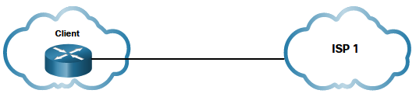
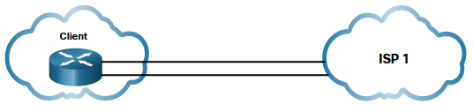
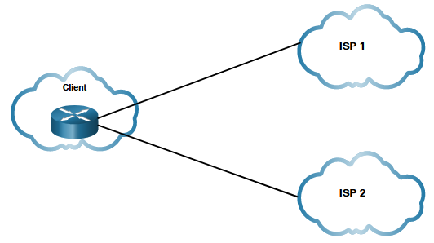
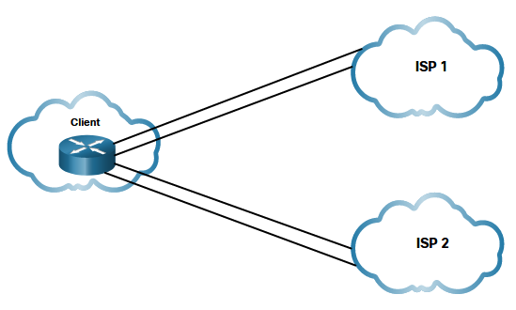
Internet-Based Connectivity ISP Connectivity Options
There are different ways an organization can connect to an ISP. The choice depends on the needs and budget of the organization.
Single-homed –Single connection to the ISP using one link. Provides no redundancy and is the least expensive solution.
Dual-homed - Connects to the same ISP using two links. Provides both redundancy and load balancing. However, the organization loses internet connectivity if the ISP experiences an outage.
Multihomed -The client connects to two different ISPs. This design provides increased redundancy and enables load-balancing, but it can be expensive.
Dual-multihomed - Dual-multihomed is the most resilient topology of the four shown. The client connects with redundant links to multiple ISPs. This topology provides the most redundancy possible. It is the most expensive option of the four.
Notes:
7.0 - WAN Concepts
7.5 – Internet-Based Connectivity
7.5.9 – ISP Connectivity Options

Slide 62
Internet-Based Connectivity Broadband Solution Comparison
Each broadband solution has advantages and disadvantages. If there are multiple broadband solutions available, a cost-versus-benefit analysis should be performed to determine the best solution.
Some factors to consider include the following:
Cable - Bandwidth is shared by many users. Therefore, upstream data rates are often slow during high-usage hours in areas with over-subscription.
DSL - Limited bandwidth that is distance sensitive (in relation to the ISP central office). Upload rate is proportionally lower compared to download rate.
Fiber-to-the-Home - This option requires fiber installation directly to the home.
Cellular/Mobile - With this option, coverage is often an issue, even within a small office or home office where bandwidth is relatively limited.
Municipal Wi-Fi - Most municipalities do not have a mesh Wi-Fi network deployed. If is available and in range, then it is a viable option.
Satellite - This option is expensive and provides limited capacity per subscriber. Typically used when no other option is available.
Notes:
7.0 – WAN Concepts
7.5 – Internet-Based Connectivity
7.5.10 – Broadband Solution Comparison

Slide 63
Internet-Based Connectivity Lab – Research Broadband Internet Access Options
In this lab, you will complete the following objectives:
Investigate Broadband Distribution
Research Broadband Access Options for Specific Scenarios
Notes:
7.0 – WAN Concepts
7.5 – Internet-Based Connectivity
7.5.11 – Lab – Research Broadband Internet Access Options

Slide 64
7.6 Module Practice and Quiz
Notes:
7.0 - ACLs for IPv4 Configuration
7.6 – Module Practice and Quiz

Slide 65
Module Practice and Quiz Packet Tracer – WAN Concepts
In this lab, you will do the following:
Describe different WAN connectivity options
Notes:
7.0 – WAN Concepts
7.6 – Module Practice and Quiz
7.6.1 – Packet Tracer – WAN Concepts

Slide 66
Module Practice and Quiz What did I learn in this module?
A Wide Area Network (WAN) is required to connect beyond the boundary of the LAN.
A private WAN is a connection that is dedicated to a single customer.
A public WAN connection is typically provided by an ISP or telecommunications service provider using the internet.
WANs are implemented using the following logical topologies: Point-to-Point, Hub-and-Spoke, Dual-homed, Fully Meshed, and Partially Meshed.
A dual-carrier connection provides redundancy and increases network availability. The organization negotiates separate SLAs with two different service providers.
Site-to-site and remote access Virtual Private Networks (VPNs) enable the company to use the internet to securely connect with employees and facilities around the world.
Modern WAN standards are defined and managed by a number of recognized authorities: TIA/EIA, ISO, and IEEE.
Layer 1 optical fiber protocol standards include SDH, SONET, and DWDM. Layer 2 protocols define how data will be encapsulated into a frame.
Layer 2 protocols include broadband, wireless, Ethernet WAN, MPLS, PPP, HDLC.
Notes:
7.0 - WAN Concepts
7.6 – Module Practice and Quiz
7.6.2 – What did I learn in this module?

Slide 67
Module Practice and Quiz What did I learn in this module?
Serial communication transmits bits sequentially over a single channel. In contrast, parallel communications simultaneously transmit several bits using multiple wires.
The two most common types of circuit-switched WAN technologies are PSTN and ISDN.
Common types of packet-switched WAN technologies are Ethernet WAN and MPLS. There are two optical fiber OSI layer 1 standards.
SDH/SONET define how to transfer multiple data, voice, and video communications over optical fiber using lasers or LEDs over great distances.
Circuit-switched connections were provided by PSTN carriers.
ISDN is a circuit-switching technology that enables the PSTN local loop to carry digital signals.
Packet switching segments data into packets that are routed over a shared network.
Frame Relay is a simple Layer 2 NBMA WAN technology used to interconnect enterprise LANs.
ATM technology is capable of transferring voice, video, and data through private and public networks. It is built on a cell-based architecture rather than on a frame-based architecture.
Notes:
7.0 - WAN Concepts
7.6 – Module Practice and Quiz
7.6.2 – What did I learn in this module?

Slide 68
Module Practice and Quiz What did I learn in this module?
Modern WAN connectivity options include dedicated broadband, Ethernet WAN and MPLS (packet-switched), along with various wired and wireless version of internet-based broadband.
MPLS is a high-performance service provider WAN routing technology to interconnect clients. MPLS supports a variety of client access methods (e.g., Ethernet, DSL, Cable, Frame Relay). MPLS can encapsulate all types of protocols including IPv4 or IPv6 traffic.
Internet-based broadband connectivity is an alternative to using dedicated WAN options.
Examples of wired broadband connectivity are Digital Subscriber Line (DSL), cable connections, and optical fiber networks.
Examples of wireless broadband include cellular 3G/4G/5G or satellite internet services.
DSL is a high-speed, always-on, connection technology that uses existing twisted-pair telephone lines to provide IP services to users.
Cable technology is a high-speed always-on connection technology that uses a cable company coaxial cable to provide IP services to users.
Notes:
7.0 - WAN Concepts
7.6 – Module Practice and Quiz
7.6.2 – What did I learn in this module?

Slide 69
Module Practice and Quiz What did I learn in this module?
Newer developments in wireless technology include Municipal Wi-Fi, Cellular, Satellite internet, and WiMAX.
VPN tunnels are routed through the internet from the private network of the company to the remote site or employee host.
ISP connectivity options include single-homed, dual-homed, multihomed, and dual-multihomed.
Notes:
7.0 - WAN Concepts
7.6 – Module Practice and Quiz
7.6.2 – What did I learn in this module?

Slide 70
Module 7: WAN Concepts New Terms and Commands
public WAN private WAN single-carrier WAN connection dual-carrier WAN connection Synchronous Digital Hierarchy (SDH) Synchronous Optical Networking (SONET) Dense Wavelength Division Multiplexing (DWDM) data terminal equipment (DTE) date communication equipment (DCE) customer premises equipment (CPE) point-of-presence demarcation point local loop last mile central office (CO) toll network backhaul network | Voiceband modem DSL modem cable modem CSU/DSU optical converter serial communication synchronous Digital Hierarchy (SDH) synchronous Optical Networking (SONET) Dense Wavelength Division Multiplexing (DWDM) T-carrier E-carrier frame relay asynchronous transfer mode (ATM) dark fiber metropolitan Ethernet (Metro E) Ethernet over MPLS (EoMPLS) Virtual Private LAN service (VPLS)

Slide 71
Module 7: WAN Concepts New Terms and Commands
label switched routers (LSRs) Customer edge (CE) router Provider edge (PE) router Internal provider (P) router DSL access multiplexer (DSLAM) PPP over Ethernet (PPPoE) Data over Cable Service Interface Specification (DOCSIS) hybrid fiber-coaxial (HFC) Cable Modem Termination System (CMTS) Fiber to the x (FTTx) Fiber to the Home (FTTH) Fiber to the Building (FTTB) Fiber to the Node/Neighborhood (FTTN) Municipal Wi-Fi

